Slide 1
PERT Revision

Slide 2
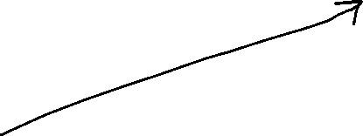
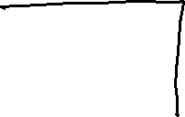




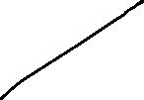

Slide 3



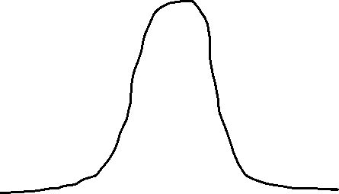



Slide 4



Slide 6







Slide 7
Slack (or float) in Activity-on-Node (AON) network diagrams represents the amount of time an activity can be delayed without delaying the project's completion date.
Calculated as LS - ES or LF - EF, slack is zero for critical path activities, while non-critical activities have positive slack.

Slide 8




Slide 9











Slide 10











Slide 11


















